Slide 1
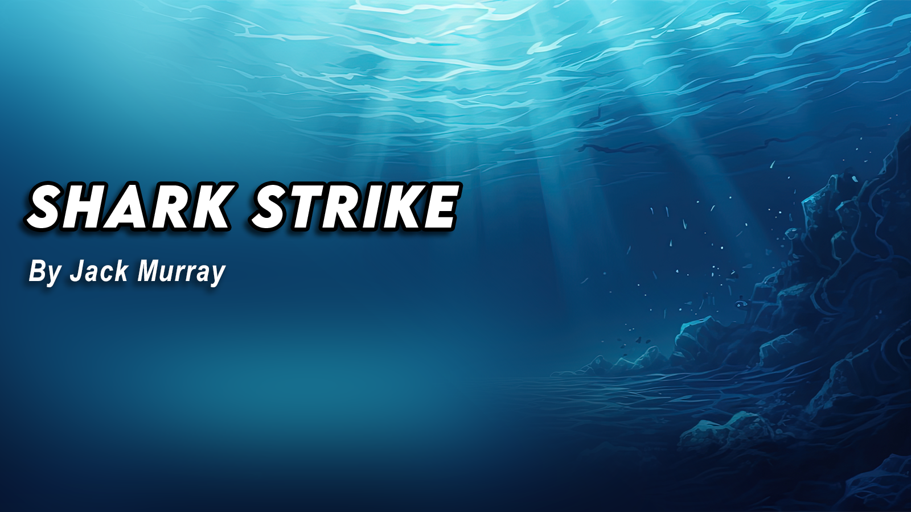

Slide 2
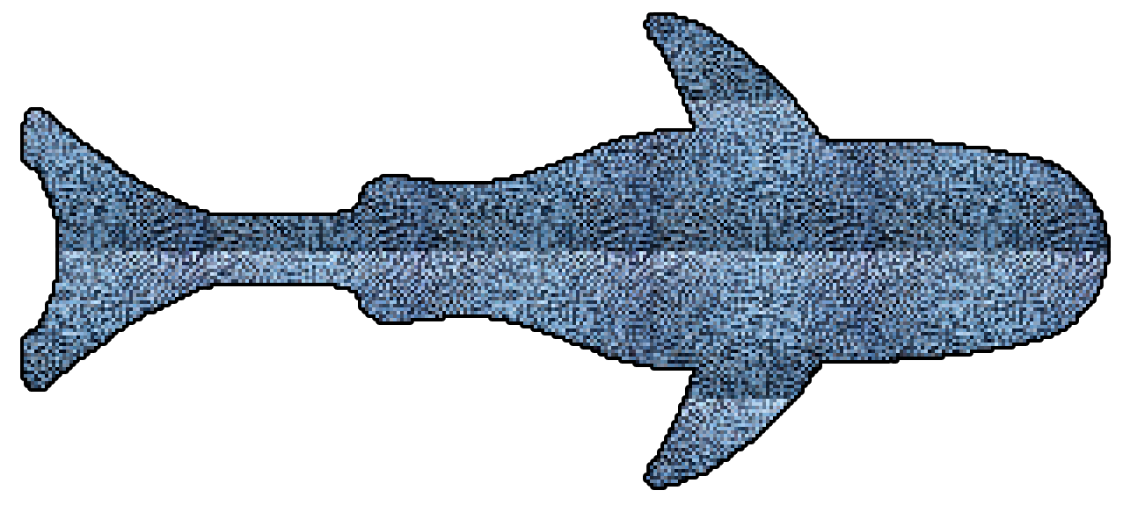
Introduction
Shark Strike is a shark-themed casual top-down shooter
Goal: collect coins and avoid bigger creatures (enemies)
Infinitely progressing, difficulty increase with time
hyper casual gaming
Developed for Android due to userbase
Figure 1: Pixel art shark asset

Slide 3
Demographic
The demographic for my game is anyone above the age of 6 (6+)
This is due to the infinitely progressing difficulty.
May end up being too difficult for younger users.

Slide 4
Market Research
Overall market research- Hyper-Casual gaming:
In 2022, 17.4 BILLION android users downloaded and played games tagged ‘hyper casual’
Top-down shooters are a growing market area currently, with many being released every year.
Most of these games are military style, or graphic, and feature maximalist art-styles.
This concept is unique in terms of style and minimalism.

Slide 5
Mechanics and Features
Controls:
Tilt to move (shark will move in direction of tilt while held)
Double tap in a direction to ‘dash/strafe’ (using gyroscope)
Tap to shoot bubbles (will have a 0.3sec delay)
Player is locked to screen bounds
enemies coming in from all sides.
Other Features:
Health bar and score counter
Haptic (vibration) feedback on shoot/take damage

Slide 6
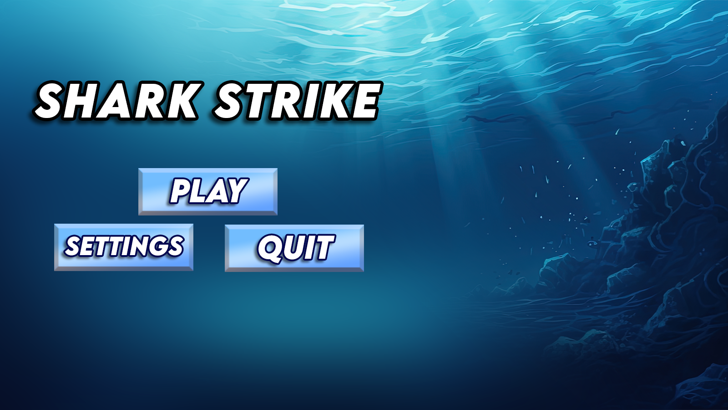
UI and level design
The UI theme for this game is very minimalistic
Easy to understand for all ages
Clean, visually appealing, easy on the eyes.
Figure 2: Prototype Title Screen Design

Slide 7
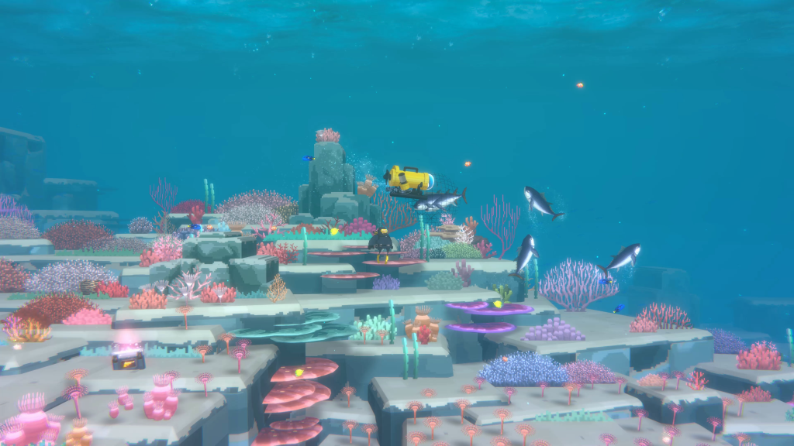
Concept art and planning
Art style = pixel art sprites, assets and backdrop
Get background art from Adobe Stock (licensed)
Take inspiration from other pixel-art
Figure 3: pixel art-inspo- Dave the Diver

Slide 8
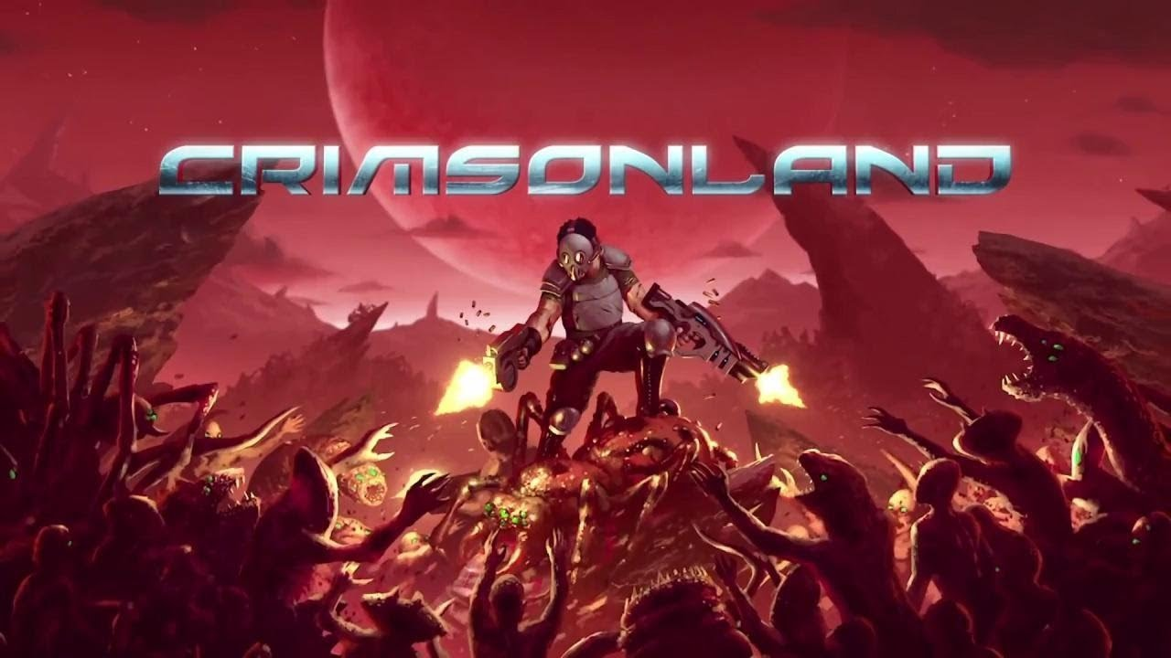
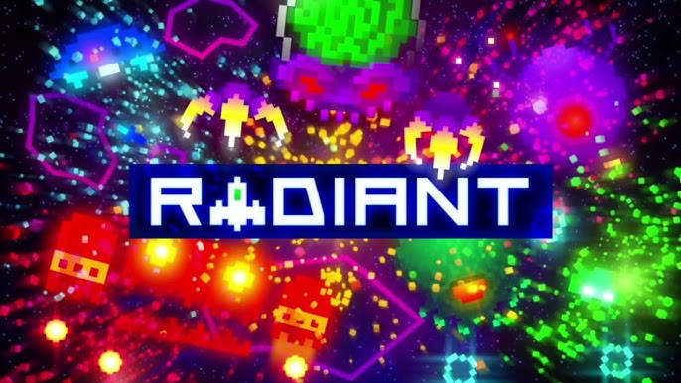

Inspiration
Figures 4, 5, 6: ‘Radiant’, ‘Crimsonland’ & ‘Warforce’

Slide 9
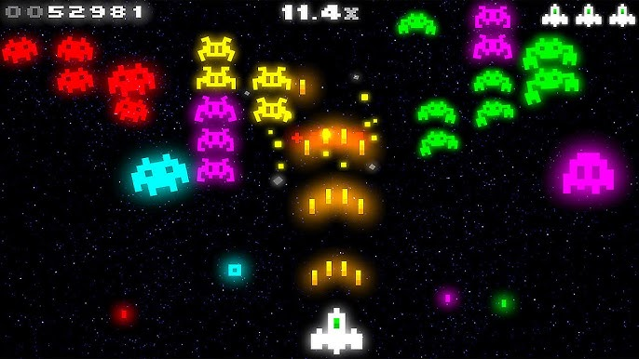
Study: Radiant
Radiant is a modernised top-down space-invaders style shooter featuring:
Unique neon pixel art style
Continuous story dialogue
An original soundtrack
This game costs £2.99
Released in 2009.
Close to 70K downloads, rated for all ages
Gross Revenue = $142,443.00
Net Revenue = $86,890.23
Figure 7: ‘Radiant’ Gameplay

Slide 10
Marketing
Shark Strike will be marketed using social media, namely Instagram stories/reels and YouTube shorts, due to their active user-bases.

Slide 11
Rapid Prototype
The current rapid prototype version features the following:
Main Menu w/ buttons
Settings menu w/ volume slider
Functioning UI (score counter and high score tracker)
WASD movement (tilt to be implemented)
Shooting and Collisions
Enemy chase mechanics

Slide 12
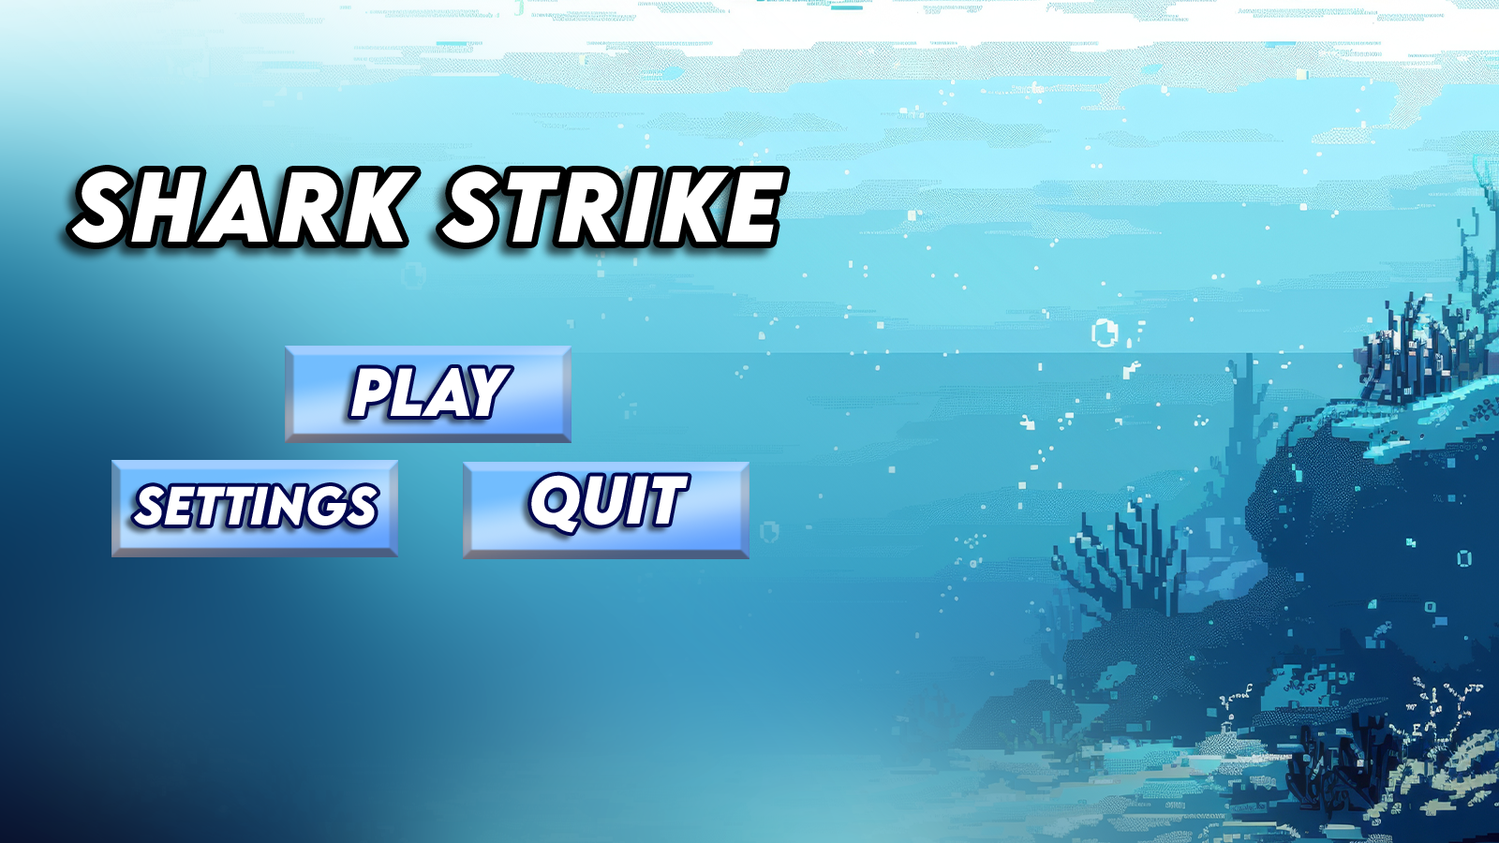
Main Menu
Here is the main menu screen
custom graphics
UI buttons
Bright and appealing
Figure 8: Finished Main Menu

Slide 13
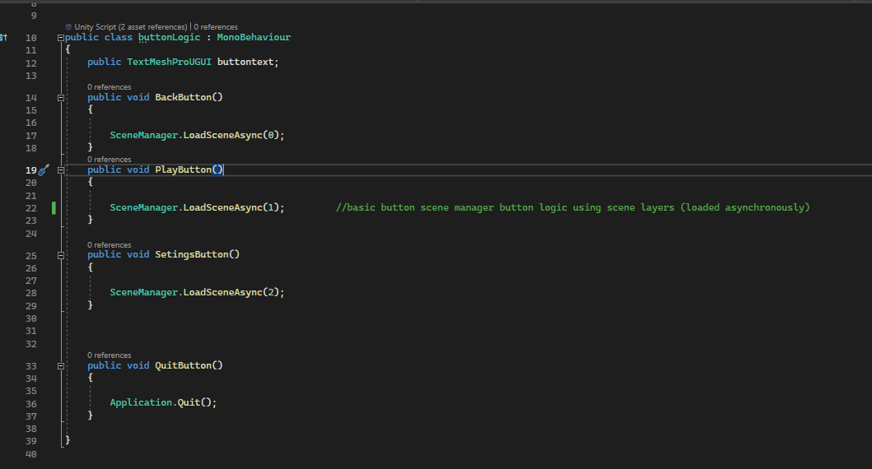
Main Menu – UI Buttons
Figure 9: Code screenshots

Slide 14
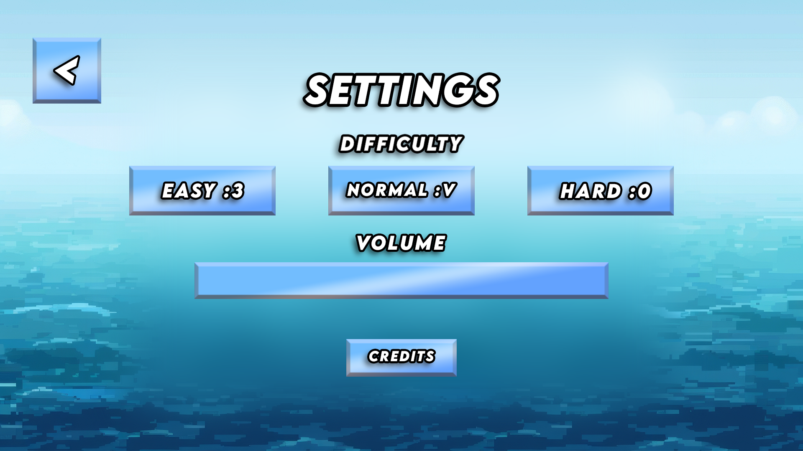
Settings Menu
Here is the main menu screen
custom graphics
Working volume slider
In-keeping with the pixel art theme
Figure 10: Settings Menu art

Slide 15
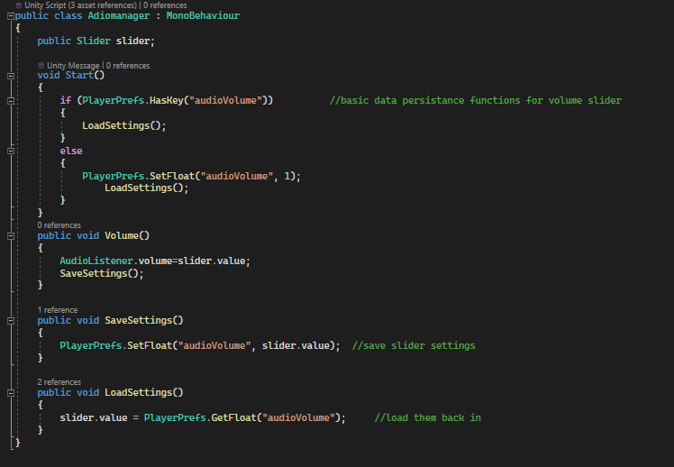
Settings Menu – Audio Slider
Data Persistence using
‘PlayerPrefs’ functionality
Figure 11: AudioManager.cs

Slide 16
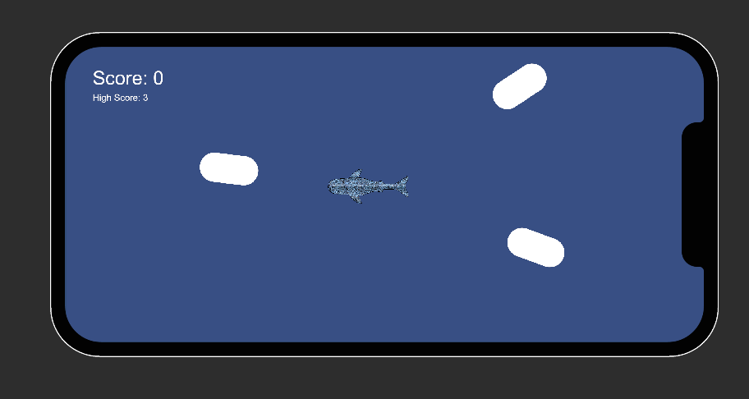
Game Scene
Here is the main game screen
Enemy AI (whiteboxed)
Shoot mechanics
Smooth controls
Figure 12: Simulated game scene

Slide 17
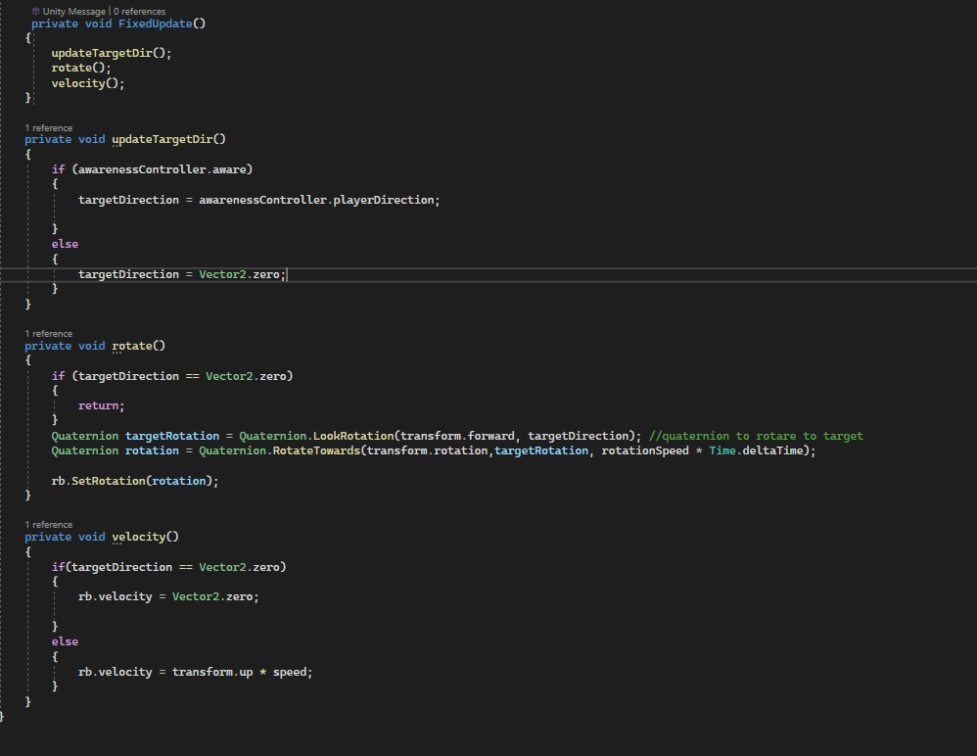
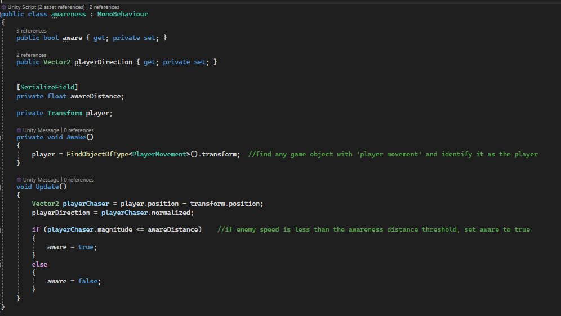
Game Scene – Enemy Scripting
Enemy Ai will rotate and follow the player when in range
Figure 13 + 14: Enemy Movement.cs, Awareness.cs

Slide 18
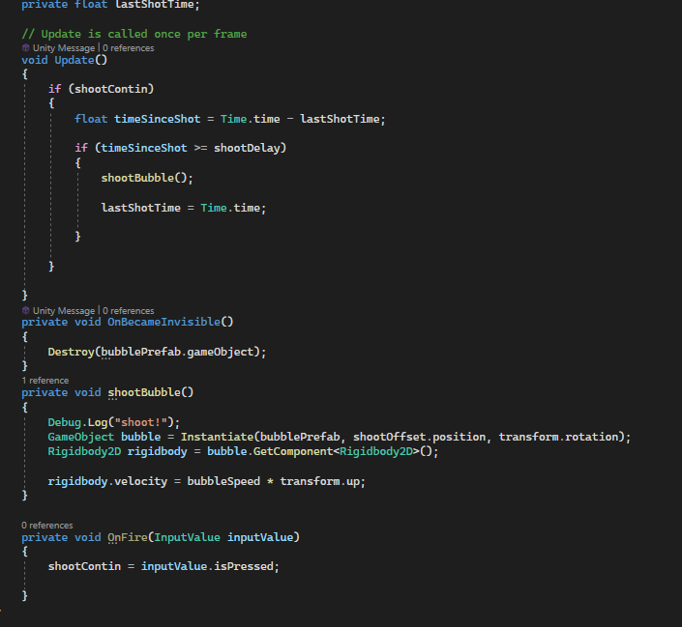
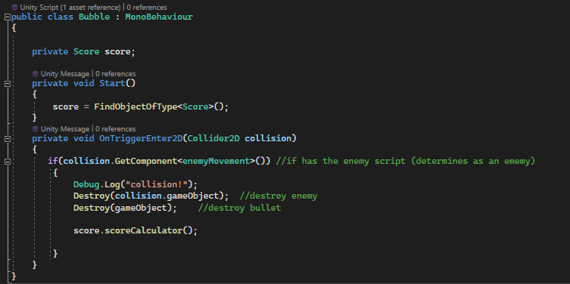
Game Scene – Shoot Mechanics
Player can shoot bullets and ‘kill’ enemy AI by tapping the screen (currently Spacebar)
Figure 15 + 16: Shoot.cs, Bubble.cs

Slide 19
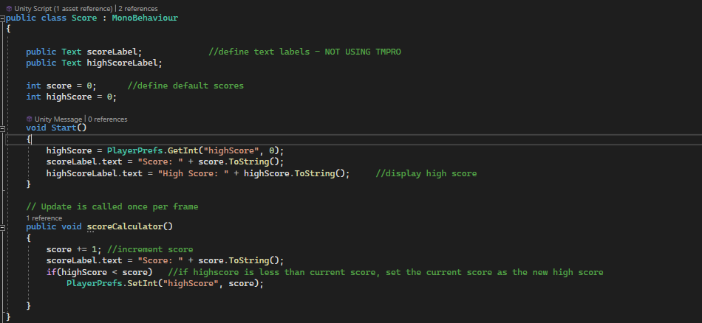
Game Scene – UI mechanics
In-game UI features a score and high score keeping mechanic
Figure 17: score.cs

Slide 20
Version Control:
This project is version controlled using GitHub, the repo is linked below:
https://github.com/UkiyoJack/MobileGameDev-JackMurray/

Slide 21
References:
Background (Menu and Settings menu):
https://stock.adobe.com/uk/search?k=pixel+underwater&search_type=usertyped&asset_id=811246306 Menu Music by StreamBeats (royalty free):
https://www.youtube.com/watch?v=vT7QvOK1So0&list=PL7MuRcFvY1Qc243qxB7yYlvcDBE5c-GBL&index=4&ab_channel=HarrisHeller-Topic
Shark character and all other graphics made by me
Logic help with enemy awareness – Ketra Games (YouTube)

